Slide 1
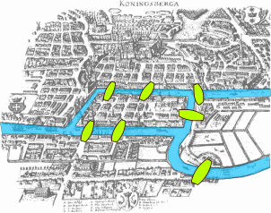
Introduction to Graphs

Slide 2
This Lecture
In this part we will study some basic graph theory.
Graph is a useful concept to model many problems in computer science.
Seven bridges of Konigsberg
Graphs, degrees
Isomorphism
Path, cycle, connectedness
Tree
Eulerian cycle
Directed graphs

Slide 3
Seven Bridges of Königsberg
Is it possible to walk with a route that crosses each bridge exactly once?

Slide 4
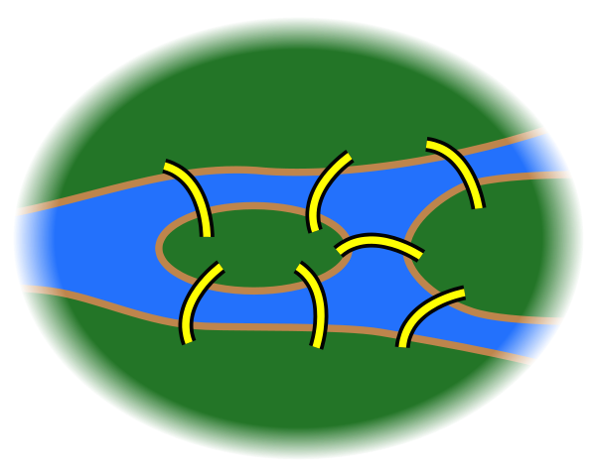
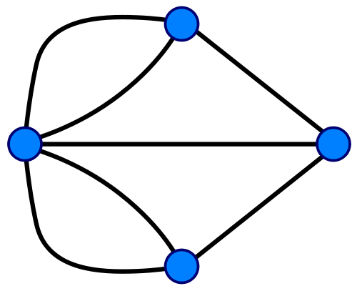
Seven Bridges of Königsberg
Forget unimportant details.
Forget even more.

Slide 5
A Graph
An edge
(or a line)
A vertex
(or a node,
or a point)
e6
d
e7
e5
e4
c
a
e3
e2
e1
b
So, what is the “Seven Bridges of Königsberg” problem now?
To find a walk that visits each edge exactly once.

Slide 6
Euler’s Solution
Question: Is it possible to find a walk that visits each edge exactly once.
e6
d
e7
e5
e4
v
c
a
e3
e2
e1
b
Suppose there is such a walk, there is a starting point and an endpoint point.
For every “intermediate” point v, there must be the same number of
incoming and outgoing edges, and so v must have an even number of edges.

Slide 7
Euler’s Solution
Question: Is it possible to find a walk that visits each edge exactly once.
e6
d
So, at most two vertices can
have odd number of edges.
e7
e5
e4
In this graph, every vertex has only an odd number of edges,
and so there is no walk which visits each edge exactly one.
c
a
e3
e2
e1
b
Suppose there is such a walk, there is a starting point and an endpoint point.
For every “intermediate” point v, there must be the same number of
incoming and outgoing edges, and so v must have an even number of edges.

Slide 8
Euler’s Solution
So Euler showed that the “Seven Bridges of Königsberg” is unsolvable.
When is it possible to have a walk that visits every edge exactly once?
Is it always possible to find such a walk if there is
at most two vertices with odd number of edges?

Slide 9
Euler’s Solution
So Euler showed that the “Seven Bridges of Königsberg” is unsolvable.
When is it possible to have a walk that visits every edge exactly once?
Is it always possible to find such a walk if there is
at most two vertices with odd number of edges?
NO!

Slide 10
Euler’s Solution
So Euler showed that the “Seven Bridges of Königsberg” is unsolvable.
When is it possible to have a walk that visits every edge exactly once?
Is it always possible to find such a walk if the graph is “connected”
and there are at most two vertices with odd number of edges?
YES!

Slide 11
Euler’s Solution
So Euler showed that the “Seven Bridges of Königsberg” is unsolvable.
When is it possible to have a walk that visits every edge exactly once?
Eulerian path
Euler’s theorem: A graph has an Eulerian path if and only if it is
“connected” and has at most two vertices with an odd number of edges.
This theorem was proved in 1736,
and was regarded as the starting point of graph theory.

Slide 12
This Lecture
Seven bridges of Konigsberg
Graphs, degrees
Isomorphism
Path, cycle, connectedness
Tree
Eulerian cycle
Directed graphs

Slide 13
Types of Graphs
Simple Undirected Graph
Directed Graph
Multi-Graph
Eulerian path problem

Slide 14
Simple Graphs
a
A graph G=(V,E) consists of:
A set of vertices, V
A set of undirected edges, E
b
f
c
V(G) = {a,b,c,d,e,f}
E(G) = {ad,af,bd,be,cd,ce,df}
e
d
G
Two vertices a,b are adjacent (neighbours) if the edge ab is present.

Slide 15
Vertex Degrees
An edge uv is incident on
the vertex u and the vertex v.
a
b
f
The neighbour set N(v) of a vertex v
is the set of vertices adjacent to it.
c
e.g. N(a) = {d,f}, N(d) = {a,b,c,f}, N(e) = {b,c}.
e
d
degree of a vertex = # of incident edges
e.g. deg(d) = 4, deg(a)=deg(b)=deg(c)=deg(e)=deg(f)=2.
the degree of a vertex v = the number of neighbours of v?
For multigraphs, NO.
For simple graphs, YES.

Slide 16
Degree Sequence
Is there a graph with degree sequence (2,2,2)?
YES.
Is there a graph with degree sequence (3,3,3,3)?
YES.
Is there a graph with degree sequence (2,2,1)?
NO.
2
2
1
Is there a graph with degree sequence (2,2,2,2,1)?
Where to go?
NO.
What’s wrong with these sequences?

Slide 17
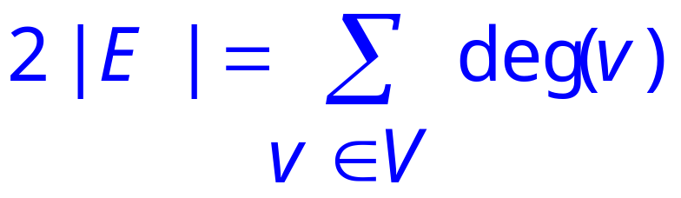
Handshaking Lemma
For any graph, sum of degrees = twice # edges
Lemma.
Corollary.
Sum of degree is an even number.
Number of odd degree vertices is even.
Examples. 2+2+1 = odd, so impossible.
2+2+2+2+1 = odd, so impossible.

Slide 18
Handshaking Lemma
Lemma.
Proof.
Each edge contributes 2 to the sum on the right.
Q.E.D.
Question. Given a degree sequence, if the sum of degree is even,
is it true that there is a graph with such a degree sequence?
For simple graphs, NO, consider the degree sequence (3,3,3,1).
For multigraphs (with self loops), YES! (easy by induction)

Slide 19
This Lecture
Seven bridges of Konigsberg
Graphs, degrees
Isomorphism
Path, cycle, connectedness
Tree
Eulerian cycle
Directed graphs

Slide 20
Same Graphs?
Same graph (different drawings)
257
122
257
122
145
99
306
67
99
67
306
145
Same graph (different labels)
257
122
145
Albert
Grant
Sharat
306
67
Christos
Sonya
99
Jessica

Slide 21
Graph Isomorphism
All that matters is the connections.
Graphs with the same connections are isomorphic.
Informally, two graphs are isomorphic if they are the same after renaming.
Graph isomorphism has applications like checking fingerprint, testing molecules…

Slide 22
Are These Isomorphic?
one-to-one mapping
Hay
Dog
Pig
Corn
Cow
Cat
Beef
Tuna
f (Dog) = Beef
f (Cat) = Tuna
f (Cow) = Hay
f (Pig) = Corn

Slide 23
Are These Isomorphic?
one-to-one mapping
Hay
Dog
Pig
Corn
Cow
Cat
Beef
Tuna
Edge preserved?
YES!
If there is an edge in the original graph, there is an edge after the mapping.

Slide 24
Are These Isomorphic?
one-to-one mapping
Hay
Dog
Pig
Corn
Cow
Cat
Beef
Tuna
Non-Edge preserved?
YES!
If there is no edge in the original graph, there is no edge after the mapping.

Slide 25
Graph Isomorphism
G₁ isomorphic to G₂ means there is a one-to-one mapping of the vertices
that is edge-preserving.
 one-to-one mapping f: V₁ → V₂
u —v in E₁ iff f (u)—f (v) in E₂
uv is an edge in G1
f(u)f(v) is an edge in G2
If G1 and G2 are isomorphic, do they have the same number of vertices?
If G1 and G2 are isomorphic, do they have the same number of edges?
If G1 and G2 are isomorphic, do they have the same degree sequence?
If G1 and G2 have the same degree sequence, are they isomorphic?
YES
YES
YES
NO

Slide 26
Checking Graph Isomorphism
How to show two graphs are isomorphic?
Find a mapping and show that it is edge-preserving.
How to show two graphs are non-isomorphic?
Find some isomorphic-preserving properties
which is satisfied in one graph but not the other.
Non-isomorphic
degree 2
all degree 3

Slide 27
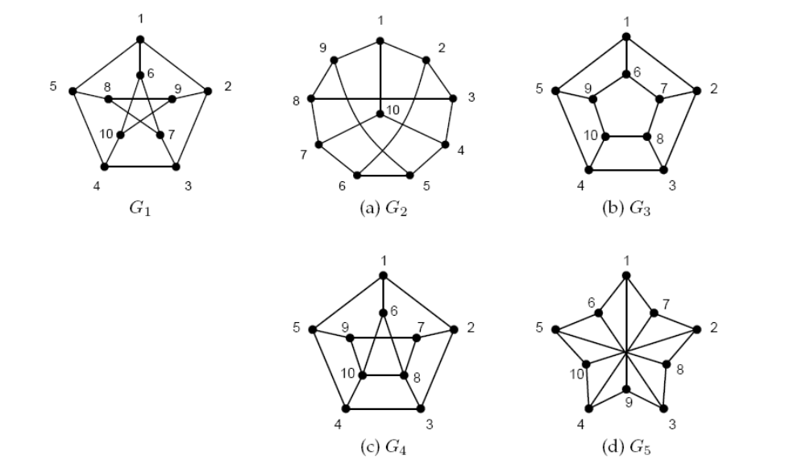
Exercise
Which is isomorphic to G1?
Testing graph isomorphism is not easy –
No known general method to test graph ismorphism
much more efficient than checking all possibilities.

Slide 28
This Lecture
Seven bridges of Konigsberg
Graphs, degrees
Isomorphism
Path, cycle, connectedness
Tree
Eulerian cycle
Directed graphs

Slide 29
Paths
Path: sequence of adjacent vertices
(
)

Slide 30
Simple Paths
Simple Path: all vertices different
(
)

Slide 31
Connectedness
Vertices v, w are connected if and only if
there is a path starting at v and ending at w.
A graph is connected iff every pair of vertices are connected.
Every graph consists of separate connected pieces called connected components
13
12
26
16
66
E17
E25
10
8
4
3 connected components
So a graph is connected if and only if it has only 1 connected component.

Slide 32
Cycles
A cycle is a path that begins and ends with same vertex.
a
v
w
b
cycle: v ···b ···w ···w ···a ···v
also: a ···v ···b ···w ···w ···a

Slide 33
Simple Cycles
A simple cycle is a cycle that doesn’t cross itself
In a simple cycle, every vertex is of degree exactly 2.
v
w
cycle: v ···w ···v
also: w ···v ···w

Slide 34
Shortest Paths
A path between u and v is a shortest path
if among all u-v paths it uses the minimum number of edges.
Is a shortest path between two vertices always simple?
Idea: remove the cycle will make the path shorter.
c
u
v

Slide 35
This Lecture
Seven bridges of Konigsberg
Graphs, degrees
Isomorphism
Path, cycle, connectedness
Tree
Eulerian cycle
Directed graphs

Slide 36
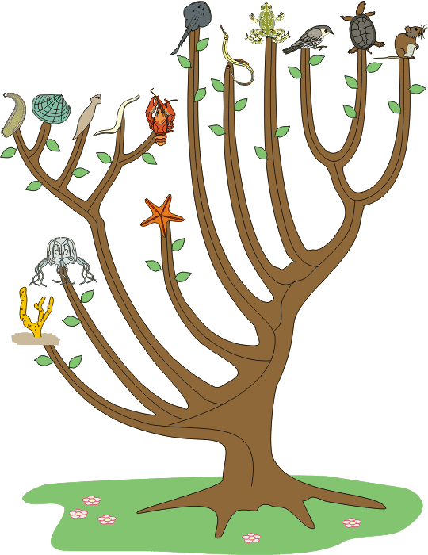
Tree
Graphs with no cycles?
A forest.
Connected graphs with no cycles?
A tree.

Slide 37
More Trees
leaf
leaf
A leaf is a vertex of degree 1.
More leaves.
Even more leaves.

Slide 38
Tree Characterization by Path
Definition. A tree is a connected graph with no cycles.
Can there be no path between u and v?
NO
Can there be more than one simple path between u and v?
NO
This will create cycles.
u
v
Claim. In a tree, there is a unique simple path between every pair of vertices.

Slide 39
Tree Characterization by Number of Edges
Definition. A tree is a connected graph with no cycles.
Can a tree have no leaves?
NO
Then every vertex has degree at least 2.
Go to unvisited edges as long as possible.
Cannot get stuck,
unless there is a cycle.

Slide 40
Tree Characterization by Number of Edges
Definition. A tree is a connected graph with no cycles.
Can a tree have no leaves?
NO
How many edges does a tree have?
n-1?
We usually use n to denote the number of vertices,
and use m to denote the number of edges in a graph.

Slide 41
Tree Characterization by Number of Edges
Definition. A tree is a connected graph with no cycles.
Can a tree have no leaves?
NO
How many edges does a tree have?
n-1?
v
Look at a leaf v.
Is T-v a tree?
YES
Can T-v has a cycle?
Is T-v connected?
NO
YES
By induction, T-v has (n-1)-1=n-2 edges.
So T has n-1 edges.

Slide 42
Tree Characterizations
Definition. A tree is a connected graph with no cycles.
Characterization by paths:
A graph is a tree if and only if
there is a unique simple path between every pair of vertices.
Characterization by number of edges:
A graph is a tree if and only if it is connected and has n-1 edges.
(We have only proved one direction.
The other direction is similar and left as an exercise.)

Slide 43
This Lecture
Seven bridges of Konigsberg
Graphs, degrees
Isomorphism
Path, cycle, connectedness
Tree
Eulerian cycle
Directed graphs

Slide 44
Eulerian Graphs
Euler’s theorem: A graph has an Eulerian path if and only if it is
connected and has at most two vertices with an odd number of edges.
Can a graph have only 1
odd degree vertex?
Odd degree vertices.
Euler’s theorem: A connected graph has an Eulerian path if and only if
it has zero or two vertices with odd degrees.
Proof by induction. Focus on the case of Eulerian cycle.

Slide 45
Eulerian Cycle
Euler’s theorem: A connected graph has an Eulerian cycle if and only if
every vertex is of even degree.
First we find an Eulerian cycle in the below example.

Slide 46
Eulerian Cycle
Euler’s theorem: A connected graph has an Eulerian cycle if and only if
every vertex is of even degree.
Note that the edges can be partitioned into five simple cycles.
Vertices of the same color represent the same vertices.

Slide 47
Eulerian Cycle
Euler’s theorem: A connected graph has an Eulerian cycle if and only if
every vertex is of even degree.
The idea is that we can construct an Eulerian cycle by adding cycle one by one.
1
2
First transverse the first cycle.

Slide 48
Eulerian Cycle
Euler’s theorem: A connected graph has an Eulerian cycle if and only if
every vertex is of even degree.
The idea is that we can construct an Eulerian cycle by adding cycle one by one.
1
6
2
3
5
4
Then transverse the second cycle.

Slide 49
Eulerian Cycle
Euler’s theorem: A connected graph has an Eulerian cycle if and only if
every vertex is of even degree.
How to deal with the third cycle?
9
1
10
2
6
8
3
5
7
4
We can “detour” to the third cycle before finishing the second cycle.

Slide 50
Eulerian Cycle
Euler’s theorem: A connected graph has an Eulerian cycle if and only if
every vertex is of even degree.
We use the same idea to deal with the fourth cycle
13
1
14
10
2
6
12
3
5
11
9
7
4
8
We can “detour” to the fourth cycle at an “intersection point”.

Slide 51
Eulerian Cycle
Euler’s theorem: A connected graph has an Eulerian cycle if and only if
every vertex is of even degree.
15
16
12
13
1
14
10
9
14
2
6
12
10
3
5
11
9
13
11
7
4
8
We can “insert” the fifth cycle at an “intersection point”.

Slide 52
Eulerian Cycle
Euler’s theorem: A connected graph has an Eulerian cycle if and only if
every vertex is of even degree.
15
1
16
12
9
2
6
14
10
3
5
13
11
7
4
8
So we have an Eulerian cycle of this example

Slide 53
Idea
In general, if we have a “partial Eulerian cycle” C*,
and it intersects with a cycle C on a vertex v,
then we can extend the “partial Eulerian cycle” C* to include C.
C*
C
v
First follow C* until we visit v, then follow C until we go back to v,
and then follow C* from v to the end.

Slide 54
Proof
We have informally proved the following claim in the previous slides.
Claim 1. If the edges of a connected graph can be partitioned
into simple cycles, then we can construct an Eulerian cycle.
Euler’s theorem: A connected graph has an Eulerian cycle if and only if
every vertex is of even degree.
We can prove Euler’s theorem if we can prove the following claim.
Claim 2. If every vertex is of even degree, then
the edges can be partitioned into simple cycles.

Slide 55
Partitioned into Simple Cycles
Claim 2. If every vertex is of even degree, then
the edges can be partitioned into simple cycles.
First we can find one cycle by the same idea as before.
Start from any vertex.
Go to unvisited edges as long as possible.
Cannot get stuck before we find a cycle,
because every vertex has degree >= 2.

Slide 56
Partitioned into Simple Cycles
Claim 2. If every vertex is of even degree, then
the edges can be partitioned into simple cycles.

Slide 57
Partitioned into Simple Cycles
Claim 2. If every vertex is of even degree, then
the edges can be partitioned into simple cycles.

Slide 58
Partitioned into Simple Cycles
Claim 2. If every vertex is of even degree, then
the edges can be partitioned into simple cycles.

Slide 59
Partitioned into Simple Cycles
Claim 2. If every vertex is of even degree, then
the edges can be partitioned into simple cycles.

Slide 60
Partitioned into Simple Cycles
Claim 2. If every vertex is of even degree, then
the edges can be partitioned into simple cycles.

Slide 61
Partitioned into Simple Cycles
Claim 2. If every vertex is of even degree, then
the edges can be partitioned into simple cycles.

Slide 62
Partitioned into Simple Cycles
Claim 2. If every vertex is of even degree, then
the edges can be partitioned into simple cycles.

Slide 63
Partitioned into Simple Cycles
Claim 2. If every vertex is of even degree, then
the edges can be partitioned into simple cycles.

Slide 64
Partitioned into Simple Cycles
Claim 2. If every vertex is of even degree, then
the edges can be partitioned into simple cycles.

Slide 65
Partitioned into Simple Cycles
Claim 2. If every vertex is of even degree, then
the edges can be partitioned into simple cycles.

Slide 66
Partitioned into Simple Cycles
Claim 2. If every vertex is of even degree, then
the edges can be partitioned into simple cycles.
Proof. Let C be a simple cycle.
Remove the edges in C from the graph G and call the new graph G’.
So the degree of each vertex is either unchanged or decreased by two.
So every vertex of the graph G’ is still of even degree.
Note that G’ has fewer edges than G.
By induction, G’ can be partitioned into simple cycles C₁, C₂, …, C_{k}.
So the original graph G can be partitioned into simple cycles, C, C₁, C₂, …, C_{k}.

Slide 67
Proof
We have informally proved the following claim in the previous slides.
Claim 1. If the edges of a connected graph can be partitioned
into simple cycles, then we can construct an Eulerian cycle.
We proved the following claim by induction.
Claim 2. If every vertex is of even degree, then
the edges can be partitioned into simple cycles.
So now we have proved Euler’s theorem.
Euler’s theorem: A connected graph has an Eulerian cycle if and only if
every vertex is of even degree.

Slide 68
This Lecture
Seven bridges of Konigsberg
Graphs, degrees
Isomorphism
Path, cycle, connectedness
Tree
Eulerian cycle
Directed graphs

Slide 69
Directed Graphs
a
A directed graph G=(V,A) consists of:
A set of vertices, V
A set of directed edges (arcs), A
b
f
c
V(G) = {a,b,c,d,e,f}
A(G) = {da, fa, db, eb, dc, ec, fd}
e
d
G
For an arc uv, we say u is the tail of the arc and v is the head of the arc.
Also, we say v is an out-neighbor of u, and u is an in-neighbor of v.
u
v

Slide 70
In-Degrees and Out-Degrees
a
b
The out-degree of a vertex v is the number of
arcs with v being tail; similarly, the in-degree of
a vertex v is the number of arcs with v being head.
f
c
e
E.g. the indegree of a is 2 and the outdegree of a is 0,
the indegree of d is 1 and the outdegree of d is 3.
d
G

Slide 71
Directed Paths
Informally, a directed path is a path that follows directions.
Directed Path: sequence of vertices v₁, v₂, …, v_{k} such that there is an
arc from v_{i} to v_{i+1} for all 1 <= i <= k-1.
Simple Directed Path: a directed path with no repeated vertices.

Slide 72
Directed Cycles
A directed cycle is a directed path that begins and ends with same vertex.
a
v
w
b
cycle: v ···b ···w ···w ···a ···v
also: a ···v ···b ···w ···w ···a
A simple directed cycle is a directed cycle with no repeated vertices except the last.

Slide 73
Eulerian Problem in Directed Graphs
Given a directed graph, when is it possible to have a directed cycle
that visits every arc exactly once?
This will be your homework problem.

